Slide 1
Object Oriented Programming and Design
Presented by
Dr Ramya Devi M
mramyadevi@wilp.bits-pilani.ac.in
CS - 06 : 02nd Aug 2025

Slide 2
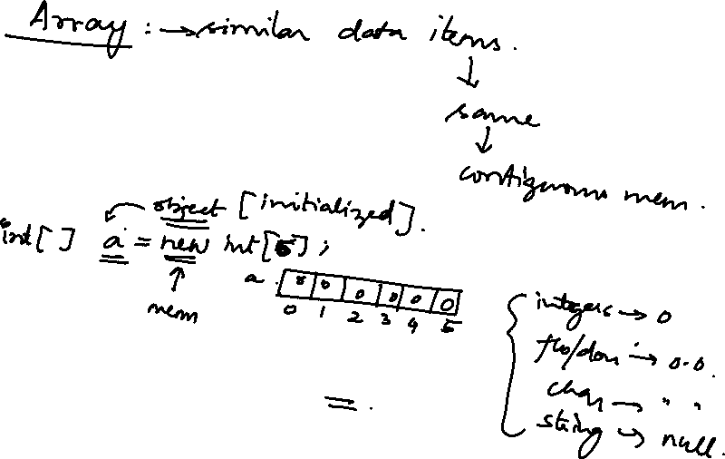
2-D Array

Slide 3
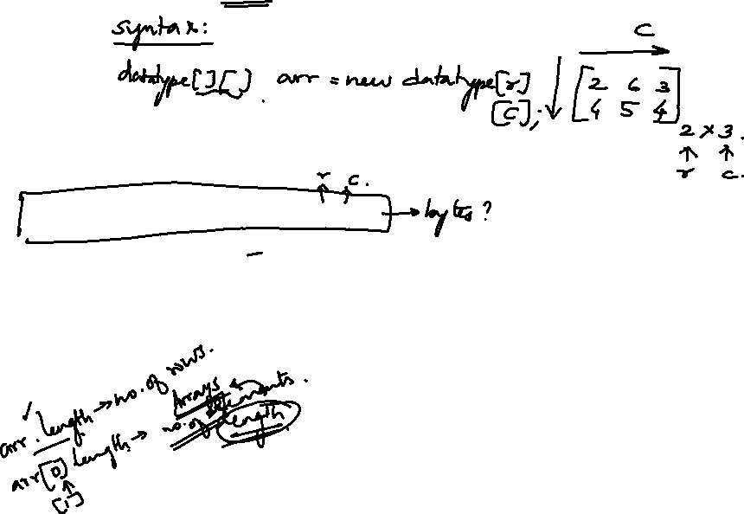
Displaying 2-D Array Elements
Two Methods
  Method 1: Using nested for { .. } loop Example :
int data[][] = new int[5][5]; System.out.println(data.length); for(int i=0; i<data.length; i++)
for(int j=0; j<data[i].length; j++)
// Displays 5 not 25
// data.length = no of rows
// each jth column under ith row
System.out.println(data[i][j]);
Method 2: Using nested for each loop
Syntax :
for(<type-of-array> [ ] <variable-i> : <array-name>) for(<type-of-array> <variable-j> : <variable-i>

Slide 4
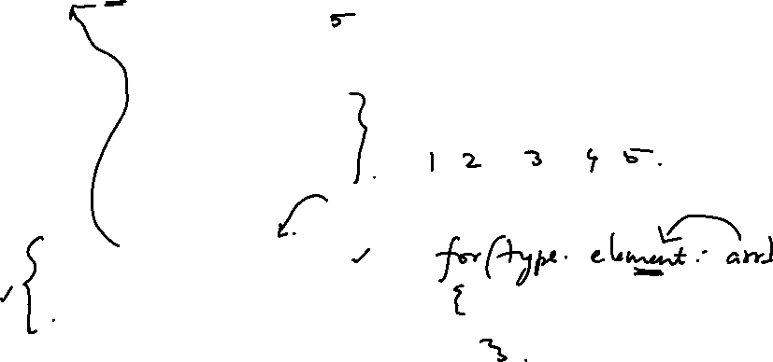
import java.util.Scanner;
public class Main {
public static void main(String[] args) {
Scanner scanner = new Scanner(System.in);
System.out.print("Enter the number of elements in the array: ");
int size = scanner.nextInt();
int[] array = new int[size];
System.out.println("Enter the elements of the array:");
for (int i = 0; i < size; i++) {
System.out.print("Enter element " + (i + 1) + ": ");
array[i] = scanner.nextInt();
}
System.out.println("The elements in the array are:");
for (int element : array) {
System.out.print(element + " ");
}
scanner.close();
}
}

Slide 5
public class SecondLargest {
public static void main(String[] args) {
int[] arr = {15, 24, 36, 48, 29};
int largest = Integer.MIN_VALUE;
int secondLargest = Integer.MIN_VALUE;
for (int value : arr) {
if (value > largest) {
secondLargest = largest;
largest = value;
} else if (value > secondLargest && value != largest) {
secondLargest = value;
}
}
System.out.println("Second largest element: " + secondLargest);
}
}

Slide 6
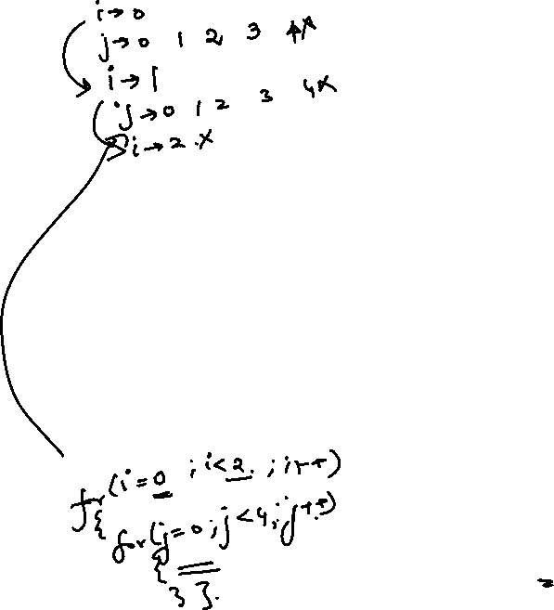
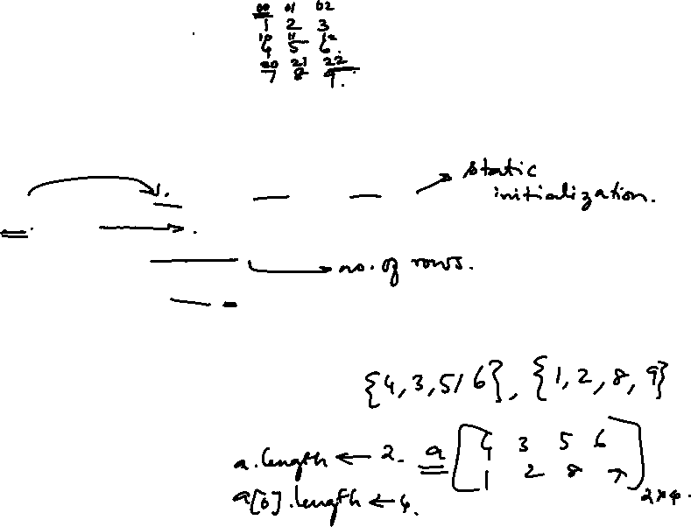
public class Main {
public static void main(String[] args) {
int[][] array = { {1, 2, 3}, {4, 5, 6}, {7, 8, 9} };
for (int i = 0; i < array.length; i++) {
for (int j = 0; j < array[i].length; j++) {
System.out.print(array[i][j] + " ");
}
System.out.println();
}
}
}

Slide 7
public class Main {
public static void main(String[] args) {
int[][] array = { {1, 2, 3}, {4, 5, 6}, {7, 8, 9} };
for (int i = 0; i < array.length; i++) {
for (int j = 0; j < array[i].length; j++) {
System.out.print(array[i][j] + " ");
}
System.out.println();
}
}
}

Slide 8
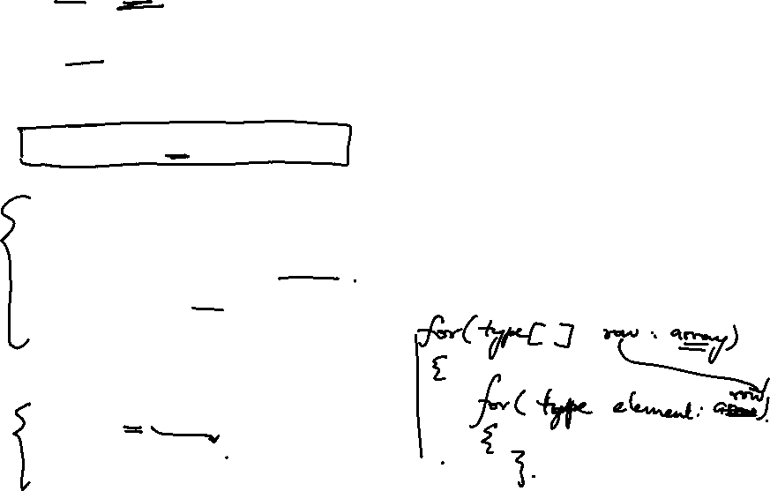
import java.util.Scanner;
public class TwoDArrayExample {
public static void main(String[] args) {
Scanner scanner = new Scanner(System.in);
System.out.print("Enter the number of rows: ");
int rows = scanner.nextInt();
System.out.print("Enter the number of columns: ");
int cols = scanner.nextInt();
int[][] array = new int[rows][cols];
System.out.println("Enter the elements of the array:");
for (int i = 0; i < rows; i++) {
for (int j = 0; j < cols; j++) {
System.out.print("Enter element at [" + i + "][" + j + "]: ");
array[i][j] = scanner.nextInt();
}
}
System.out.println("The elements in the 2D array are:");
for (int[] row : array) {
for (int element : row) {
System.out.print(element + " ");
}
System.out.println(); // Newline after each row
}
scanner.close();
}
}

Slide 9
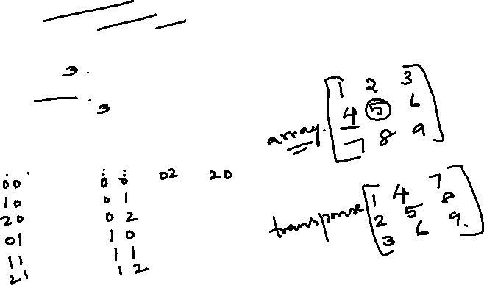
public class Main {
public static void main(String[] args) {
int[][] array = { {1, 2, 3},{4, 5, 6}, {7, 8, 9}};
int[][] transpose = new int[array[0].length][array.length];
for (int i = 0; i < array.length; i++) {
for (int j = 0; j < array[i].length; j++) {
transpose[j][i] = array[i][j];
}
}
for (int i = 0; i < transpose.length; i++) {
for (int j = 0; j < transpose[i].length; j++) {
System.out.print(transpose[i][j] + " ");
}
System.out.println();
}
}
}

Slide 10
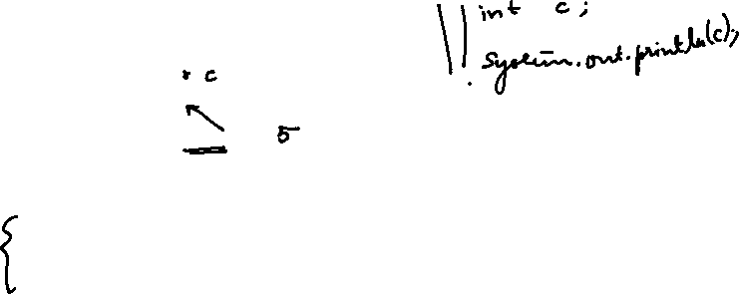
Displaying 2-D Array Elements
: Example
// File Name : Demo.java
class Demo
{
public
{
static void main(String[] args)
int[][] data = new int[5][5];
System.out.println(data.length); // Displays 5
// Method 1
System.out.println("Method 1 : Using Nested for Loop"); for(int i = 0; i < data.length; i++)
for(int j = 0; j < data[i].length; j++)
System.out.println(data[i][j]);
// Method 2
System.out.println("Method 2 : Using Nested for-each Loop"); for(int[] i : data)
for(int j : i)
System.out.println(j);
}// End of Method
}// End of class Demo

Slide 11
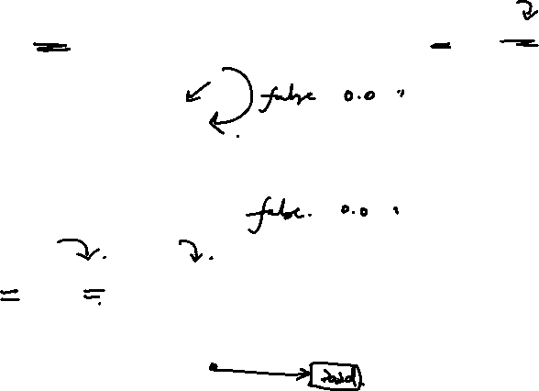
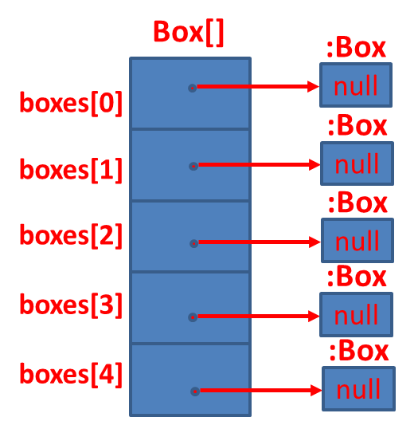
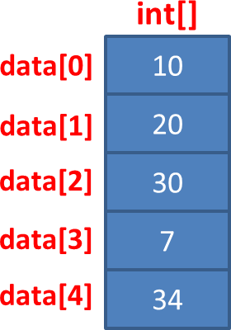
Primitive Type vs Object Type Array
int[] data = { 10, 20, 30, 7, 34 };
Box[] boxes = new
Box[5];
String[] names = { “David”, “Ram”, “Mike”};
String[] :String
names[0]
David
:String
names[1]
Ram
:String
names[2]
Mike

Slide 12
Arrays class

Slide 13
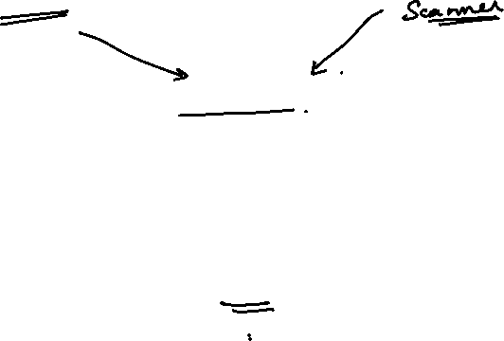
Arrays class in Java
Arrays class in <<java.util>> package is defined as
follows
This class contains the required methods for manipulating arrays such as sorting and searching
All methods are <<static>> and hence can be called via class name.
Arrays class is part of Java’s Collection Framework

Slide 14
Arrays class: Important Methods
binarySearch()
static int | binarySearch(byte[] a, byte key)
static int | binarySearch(char[] a, char key)
static int | binarySearch(double[] a, double key)
static int | binarySearch(float[] a, float key)
static int | binarySearch(int[] a, int key)
static int | binarySearch(long[] a, long key)
static int | binarySearch(Object[] a, Object key)
static int | binarySearch(Object[] a, Object key, Comparator c)
static int | binarySearch(short[] a, short key)

Slide 15
Arrays class: Important Methods ….
equals()
static boolean | equals(boolean[] a, boolean[] a2)
static boolean | equals(byte[] a, byte[] a2)
static boolean | equals(char[] a, char[] a2)
static boolean | equals(double[] a, double[] a2)
static boolean | equals(float[] a, float[] a2)
static boolean | equals(int[] a, int[] a2)
static boolean | equals(long[] a, long[] a2)
static boolean | equals(Object[] a, Object[] a2)
static boolean | equals(short[] a, short[] a2)

Slide 16
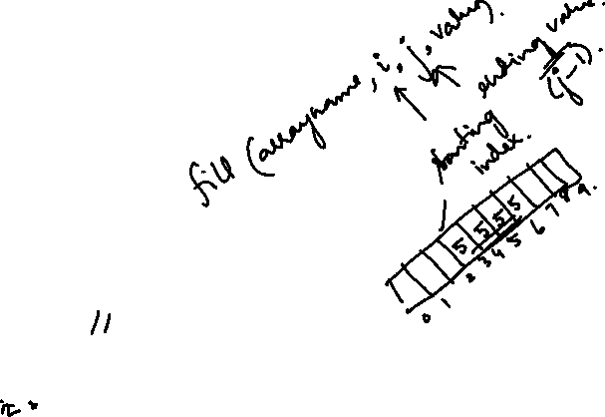
import java.util.Arrays;
public class FillRangeExample {
public static void main(String[] args) {
int[] array = new int[10];
// Fill a specific range (index 3 to 7) with the value 5
Arrays.fill(array, 3, 7, 5);
System.out.println("Array after filling a range: " + Arrays.toString(array)); // [0, 0, 0, 5, 5, 5, 5, 0, 0, 0]
}
}

Slide 17
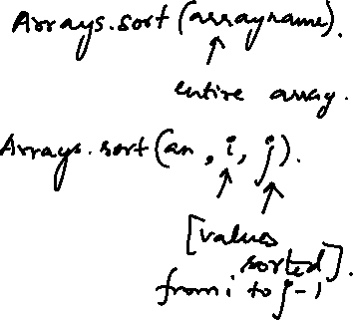
import java.util.Arrays;
public class SortRangeExample {
public static void main(String[] args) {
int[] array = {5, 2, 8, 3, 1, 7, 6};
// Sort a specific range (index 2 to 5)
Arrays.sort(array, 2, 6);
System.out.println("Array after range sort: " + Arrays.toString(array)); // [5, 2, 1, 3, 7, 8, 6]
}
}

Slide 18
Arrays class: Important Methods ….
fill()
static void | fill(boolean[] a, boolean val)
static void | fill(boolean[] a, int fromIndex, int toIndex,
 | boolean val)
static void | fill(byte[] a, byte val)
static void | fill(byte[] a, int fromIndex, int toIndex, byte val)
static void | fill(char[] a, char val)
static void | fill(char[] a, int fromIndex, int toIndex,
 | char val)
static void | fill(double[] a, double val)
static void | fill(double[] a, int fromIndex, int toIndex,
 | double val)
static void | fill(float[] a, float val)

Slide 19
Arrays class: Important Methods ….
fill() ….
static void | fill(float[] a, int fromIndex, int toIndex, float val)
static void | fill(int[] a, int val)
static void | fill(int[] a, int fromIndex, int toIndex, int val)
static void | fill(long[] a, int fromIndex, int toIndex,
 | long val)
static void | fill(long[] a, long val)
static void | fill(Object[] a, int fromIndex, int toIndex,
 | Object val)
static void | fill(Object[] a, Object val)
static void | fill(short[] a, int fromIndex, int toIndex,
 | short val)
static void | fill(short[] a, short val)

Slide 20
Arrays class: Important Methods ….
sort()
static void | sort(byte[] a)
static void | sort(byte[] a, int fromIndex, int toIndex)
static void | sort(char[] a)
static void | sort(char[] a, int fromIndex, int toIndex)
static void | sort(double[] a)
static void | sort(double[] a, int fromIndex, int toIndex)
static void | sort(float[] a)
static void | sort(float[] a, int fromIndex, int toIndex)
static void | sort(int[] a)
static void | sort(int[] a, int fromIndex, int toIndex)

Slide 21
Arrays class: Important Methods ….
sort()….
static void | sort(long[] a)
static void | sort(long[] a, int fromIndex, int toIndex)
static void | sort(Object[] a)
static void | sort(Object[] a, Comparator c)
static void | sort(Object[] a, int fromIndex, int toIndex)
static void | sort(Object[] a, int fromIndex, int toIndex, Comparator c)
static void | sort(short[] a)
static void | sort(short[] a, int fromIndex, int toIndex)

Slide 22
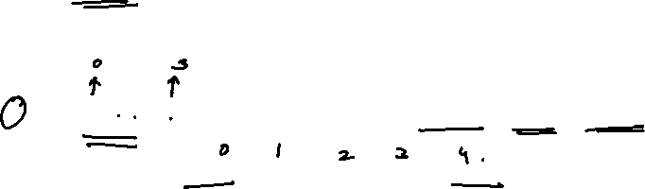
Arrays class: Example
import java.util.*; class ArrayExample
{
Import java.util package to use
Arrays class
public static void main(String args[])
{
int x[] = {10,6,8,20};
int array Size = 4 LB=0 UB =3
double data[]
= { 12.5,34.6,90.56,12.34,12.56};
double array Size = 5 LB=0 UB =4
float values[] = { 10.45f,23.56f,12.67f};
float arrays Size = 3 LB=0 UB =2
double data1[] = new double[10];
double array Size = 10 LB=0
UB =9
boolean flags[] = new boolean[5];
boolean array Size = 5 LB=0 UB =4
int x1[] = {10,6,8,20};
int array Size = 4 LB=0 UB =3

Slide 23
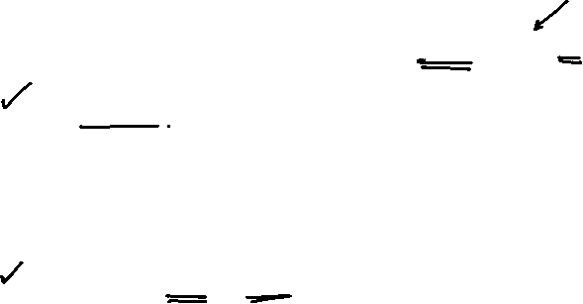
Arrays class: Example ….
System.out.println(Arrays.binarySearch(x,20));
Arrays.sort(x);
Prints index of 20 in x
Sorts elements of x
Prints Elements of x
3
for(int i=0;i<x.length;i++) System.out.print(x[i]+" "); System.out.println();
Arrays.fill(data1,12.56);
6 8 10 20
Fills a single value
12.56 in all indexes of
data1
for(int i=0;i<data1.length;i++) System.out.print(data1[i]+" "); System.out.println();
Prints Elements of data1
12.56 12.56 12.56 12.56 12.56 12.56 12.56 12.56 12.56 12.56

Slide 24
Arrays class: Example ….
Arrays.fill(flags,2,5,true);
//Arrays.fill(flags,2,6,true); for(int i=0;i<flags.length;i++) System.out.print(flags[i]+" "); System.out.println();
System.out.println(Arrays.equals(x,x1));
Arrays.sort(values);
for(int i=0;i<values.length;i++) System.out.print(values[i]+" "); System.out.println();
}
} // End of class
Fills true value in boolean array flags from index 2 to 4
ArrayIndexOutofBoundsException
false false true true true
Prints true or false whether x
and x1 equals
Sorts the elements of arrays
10.45 12.67 23.56

Slide 25
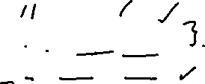
Array : Examples
10
8
6
int a[] = { 10,8,6};
for(int i=0;i<a.length;i++) System.out.println(a[i]);
']' expected
int a[3] = { 10,8,6};
^
1 error
int a[3] = { 10,8,6};
for(int i=0;i<a.length;i++)
System.out.println(a[i]);
//int table[][]={0,0,0,1,1,1};
//int table[2][3]={0,0,0,1,1,1};
WRONG
int table[ ][ ]={{0,0,0},{1,1,1}};
for(int i=0; i<table.length;i++)
{
for(int j=0;j<table[i].length;j++)
{
System.out.print(table[i][j]);} System.out.println();
000
111
}

Slide 26
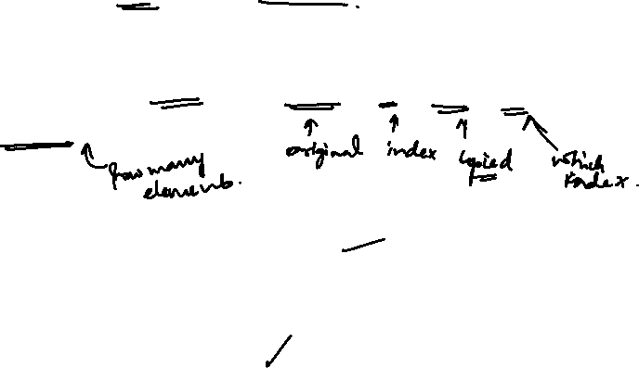
public class CopyArray {
public static void main(String[] args) {
int[] original = {10, 20, 30, 40, 50};
int[] copy = new int[original.length];
System.arraycopy(original, 0, copy, 0, original.length);
System.out.println("Copied array:");
for (int value : copy) {
System.out.print(value + " ");
}
}
}

Slide 27
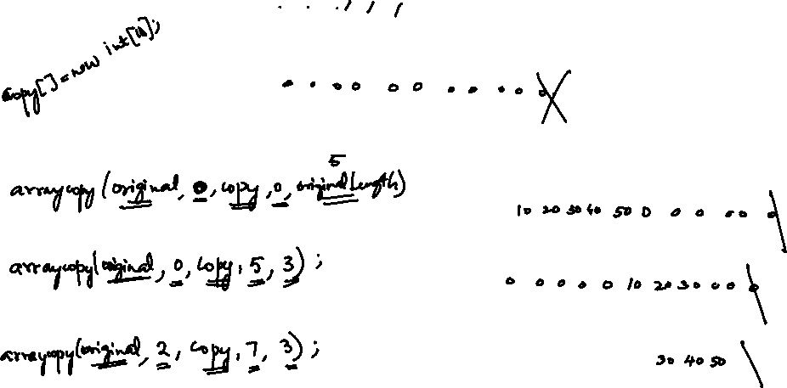
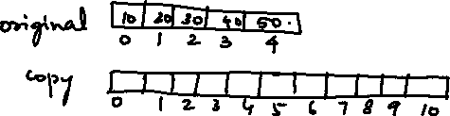


Slide 28
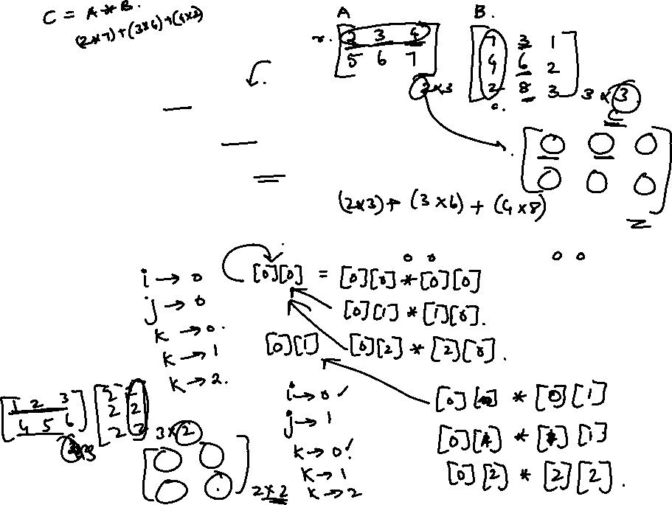
for (int i = 0; i < rowsA; i++) {
for (int j = 0; j < colsB; j++) {
for (int k = 0; k < colsA; k++)
{
productMatrix[i][j] += matrixA[i][k] * matrixB[k][j];
}
}
}

Slide 29
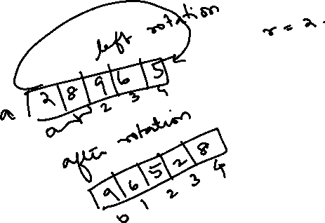

Slide 30
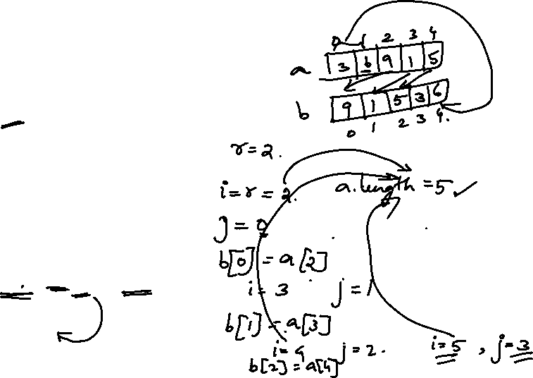
import java.util.Scanner;
public class Main {
public static void main(String[] args)
{
Scanner scanner = new Scanner(System.in);
int a[] = new int[5];
int b[] = new int[5];
int r,i,j;
for(i=0;i<5;i++)
{
a[i] = scanner.nextInt();
}
System.out.print("Enter r: ");
r = scanner.nextInt();
for(i=r,j=0;i<a.length;i++,j++)
{
b[j] = a[i];
}

Slide 31
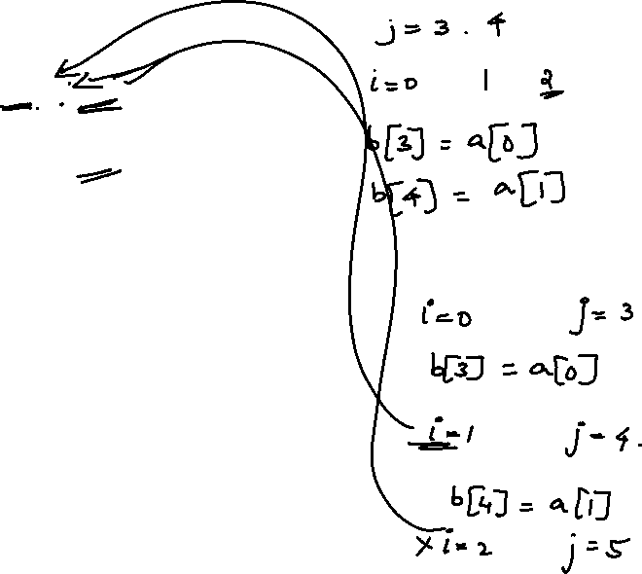
for(i=0;i<r;i++,j++)
{
b[j] = a[i];
}
for(int element : b)
{
System.out.print(element+ " ");
}
}
}

Slide 32
Thanks

